Slide 1
第2章 交互处理
进程组织
进程交互
进程协作
分布式互斥
选举
组通信中的排序组播
参考文献：
CDK5, Chapter 15, Coordination and Agreement

Slide 2
3. 进程协作

Slide 3
进程协作
进程协作举例：多个并发进程要求访问共享资源时，进程在共享资源上如何协调工作，才能不致于发生冲突，且保证共享资源的正确性和完整性?
进程协作分类：
如何保证临界区资源的互斥利用—分布式互斥
如何从多个并发进程中选举出一个进程扮演协调者—选举
如何就一组进程间发生的事件的发生顺序达成一致—事件排序；组通信中的排序组播
要求一组进程对共享资源进行公平的原子访问，不出现死锁，不出现饿死—分布式死锁
在异步网络中模拟时钟的滴答(tick,round)—同步器

Slide 4
有序组播
FIFO排序：如果一个进程发multicast(g, m)，然后发multicast(g, m’)，那么，每个传递m’的正确的进程将在m’前传递m
因果排序：如果 multicast(g, m) → multicast(g, m’)，其中 → 是发生在先关系且只由g的成员之间发送的消息引起，那么，任何传递m’的正确的进程将在m’前传递m
因果排序隐含FIFO排序
全排序：如果一个正确的进程在传递m’前传递消息m，那么，任何其它传递m’的正确的进程将在m’前传递m
全排序未必是FIFO或因果排序
混合排序：FIFO-全排序，因果-全排序

Slide 5
有序组播举例
有序组播并不隐含可靠性。例如，在全排序下，如果正确的进程p传递消息m然后传递m’，那么正确的进程q可以传递m而不传递m’或按序排在m后的任何消息。

Slide 6
3.1分布式互斥
目标：实现对进程共享资源的排他性访问，保证访问共享资源的一致性
保证在任何一个时刻，最多只能有一个进程访问共享资源
具体手段：基于消息传送
在分布式系统中，共享变量或者单个本地操作系统内核提供的设施都不能被用来解决这个问题

Slide 7
基本概念
进程的历史：由这个进程发生的事件组成
系统的全局历史：系统中的单个进程历史的并集
系统执行的割集(cut)：进程历史前缀的并集形成系统全局历史的子集
割集的边界：是指由进程处理的最后一个事件的集合
一致的割集：如果对这个割集包含的每个事件，它也包含了所有在该事件之前发生的所有事件
一致的全局状态：指相对于一致割集的状态
走向(run)是对全局历史中所有事件的全排序，同时，它与每个本地历史排序是一致的
一致的走向(consistent run)或线性化走向(linearization) 是与全局历史上的发生在先关系一致的所有事件的一个排序
不是所有的走向都经历一致的全局状态，但所有线性化走向仅经历一致的全局状态
如果有一个经过状态S和S’的线性化走向，那么状态S’是从状态S可达的

Slide 8
基本概念
设S0是系统的原始状态
安全性(safety)：设α是一个系统全局状态不希望有的性质，该性质是一个系统全局状态的谓词。关于α的安全性是一个断言，即，对所有可从S0到达的所有状态S，α的值为False
Bad things never happen
活性(liveness)：设β是一个系统全局状态希望有的性质。关于β的活性是指对任一从状态S0开始的线性化走向L，对可从S0到达的状态SL，β的值为True
Good things eventually happen

Slide 9
Essential requirements for mutual exclusion
ME1: (mutual exclusion, a safety property) at most one process may execute in the critical section (CS) at a time
ME2: (freedom from deadlocks and livelocks) requests to enter and exit the critical section eventually succeed
ME2 implies freedom from both deadlock (at least one process must be eligible to enter its critical section: a safety property) and starvation (every process trying to enter the CS must eventually succeed: a liveness property)
ME3: (→ ordering) if one request to enter the CS happened-before another, then entry to the CS is granted in that order
Fairness property
the absence of starvation
keep the fair order in which processes enter the CS

Slide 10
互斥算法的评价标准
消耗的带宽，与在每个进入临界区和退出临界区操作中发送的消息数成比例
客户的延迟时间，在每个进入和退出操作中由进程导致的客户延迟
对系统吞吐量的影响，用同步延迟衡量
吞吐量是每秒能处理的对临界区操作的请求个数
吞吐量 = 1/(同步延迟+进程在临界区内工作的最大时间值)
同步延迟：一个进程离开临界区和下一个进程进入临界区之间的时间

Slide 11
中央服务器互斥算法
假设系统是异步的，进程不出故障，并且采用异步消息传递(optional)，消息传递是可靠的，这样任何传递的消息最终都被完整地发送恰好一次
为进入一个临界区，一个进程向服务器发送一个请求消息并等待服务器的权标(token)。如果在请求时没有其它进程拥有这个权标，服务器就立刻应答来授予权标。如果此时另一进程持有这个权标，服务器就不应答而是把请求放入队列
进程在退出临界区时，发一个消息给服务器，交回这个权标。如果等待进入临界区的进程队列不空，那么，服务器就会选择时间最早的进程，把它从进程队列中删除并给这个进程一个应答。这样，这个进程就持有了权标

Slide 12
中央服务器互斥算法
A central server algorithm
A token-based centralized solution

Slide 13
算法分析
如果系统不发生故障，满足ME1、ME2
不满足ME3(顺序条件)
反例：进程A先发进入临界区的请求r_{a}，然后给进程B发一个消息m。B在收到m后，发进入临界区的请求r_{b}。如果要满足顺序条件，应该先处理A的请求，再处理B的请求。由于消息传递有延迟，B的请求可能会先于A的请求到达服务器，所以服务器会先处理B的请求。
性能(假设采用异步消息传递)
消息数量和延迟：进入临界区需要两个消息(请求和随后的授权)，客户被延迟了这对消息的往返时间；退出临界区需要一个释放消息，客户端没有发生延迟
同步延迟：发到服务器的释放消息，和随后让下一进程进入临界区的授权消息，这两个消息之间花的总时间
吞吐量：服务器可能会成为整个系统的一个性能瓶颈
服务器会造成单点失败
需要后备(backup)节点

Slide 14
基于环的互斥算法
把进程安排成环，环的拓扑结构可以与计算机之间的物理互连无关。每个进程p_{i}只需与环中下一个进程p_{(i+1) mod N}有一个通信通道
权标在进程环中沿着环顺时针或逆时针传递，获得权标，就能访问共享资源
如果一个进程在收到权标时不需要进入临界区，那么它立即把权标传给它的邻居。需要权标的进程将一直等待，直到接收到权标，它在访问共享资源时，会保留权标。为了退出临界区，进程把权标发送到它的邻居
A ring-based algorithm
A token-based distributed solution

Slide 15
算法分析
满足安全性、活性条件
不满足顺序条件(ME3)
反例：P1→ P2→ P3→P1。P1，P2，P3形成一个传递权标的通信环路。P1先发请求，想进入临界区，然后P1给P3发消息，即P1、P3构成发生在先关系，P1→P3，然后P3发请求，也想进入临界区。但目前权标在P2，所以先传到了P3，所以P3的请求先获得了满足
性能
该算法连续地消耗网络带宽
请求进入临界区的进程会延迟0个(这时，它正好收到权标)到N个(这时，它刚传递了权标)消息
退出临界区只需要一个消息
在一个进程离开和下一个进程进入临界区之间的同步延迟可以是1到N个消息传输
故障的检测和处理
故障：进程崩溃，消息(token)丢失

Slide 16
Lamport Algorithm: Using multicast and logical clocks
Assumptions: message passing is FIFO and reliable, but asynchronous.
The extended timestamp is in the form of (C(event), process id)
For events a and b, a➔b if either of the following is true
C(a)<C(b)
C(a)=C(b) but pid(a)<pid(b), where pid is the process identifier
Each process P_{i} maintain a local request queue Q.
Timestamped requests are sorted in total order ➔ in Q.
There are three messages: Request, Reply, Release message

Slide 17
Steps
P_{i} makes a request by sending a message Request (C(req_{i}),i) to all process, including itself
When P_{j} receives a request message Request (C(req_{i}),i) from P_{i}, it puts into Q and sends a reply message Reply (C(rep_{j}),j) to P_{i}
P_{i} can enter its CS and use the resource when the following two conditions are true:
P_{i}’s own request is at the head of Q, and
P_{i} has received a message r_{k} (either Request, Reply or Release) from all process P_{k} with timestamp C(r_{k}), such that (C(req_{i}),i) < (C(r_{k}),k)
P_{i} release the source by removing its request from Q, and send a release message Release (C(rel_{i}),i) to all processes.
When P_{j} receives a release message from P_{i}, it removes P_{i}’s request from Q.
马上给应答

Slide 18
Example
41
41
P3
使用资源
Reply43
P1
41 34
41
41
Reply 43
Reply 39
41
34
34
34
Release 48
41
P2
Reply 43
Release 48
34
41
34
使用资源

Slide 19
The example in terms of space-time diagram
Note that at local time 44, P2 may start using the resource, since it has already received a message from P1 with a larger timestamp of value 41 than P2’s request of value 34.
Furthermore, this solution grants resource in an order consistent with the happens-before relation (no priority inversion).
P1
P2
P3
Request
Reply

Slide 20
Correctness-I
Mutual exclusion
All queues are ordered the same way, and a request cannot be granted until it is at head (step 3-a) and no request of a smaller timestamp can arrive (step 3-b)
This depends on reliable FIFO messages
Receiving a message means that all old messages are received.
Receiving a message from all processes with timestamps larger than that of request means no future request will come with a smaller timestamp.
No two processes get resource at the same time

Slide 21
Correctness-II
Progress
Step 2 guarantees that after Pi requests the resource, reply messages to Pi will eventually arrive, and so the condition in step 3-b will eventually hold.
Steps 4 and 5 imply that if each process which is granted the resource eventually release it, then the condition in step 3-a will eventually hold.
As a result, Step 3 will be executed.
FIFO fairness
All local queues are sorted according to →, which is the same on each process.
All accesses to the resource follow the order of the queue.

Slide 22
设(i,reqj/ackj)表示进程i发请求/确认给j的时间戳
(反证法) 假设进程i的请求的时间戳<进程j的请求的时间戳。若j比i先进入CS，那么j应该还没有收到 来自i的请求。根据step 3-b，它应该收到 来自i的对j请求的确认(i,reqj)
由于通道是FIFO，所以，来自i的对j请求的确认 应该 在 来自i的请求 之前发生(i,ackj) < (i,reqj)
由于先有请求，后才有确认，所以，来自j的请求 在 来自i的对j请求的确认 之前发生(j,reqi) < (i,ackj)
所以，来自j的请求 在 来自i的请求 之前发生
假设 (i, reqj) <(j, reqi)
但 (i,ackj) < (i,reqj)，而且，(j,reqi) < (i,ackj)
推出：(j,reqi) < (i,ackj) <(i,reqj)，故矛盾

Slide 23
Ricart-Agrawala algorithm: an optimized version of Lamport’s solution
Each process seeking entry into its CS sends a timestamped request to every other process in the system
A process receiving a request sends a reply back to the sender, only when (i) the process is not interested in entering its CS, or (ii) the process is trying to enter its CS, but its timestamp is larger than that of the sender. If the process is already in its CS, then it will buffer all requests until its exit from CS
A process enters its CS, when it receives an reply from each of the remaining n-1 processes
Upon exit from its CS, a process must send reply to each of the pending requests before making a request or executing other actions

Slide 24
Ricart-Agrawala algorithm
On initialization:
state := RELEASED;
To enter the section:
state := WANTED;
multicast request <T, pi> to all processes where T:= request’s timestamp;
wait until (number of replies received= (N – 1));
state := HELD;
On receipt of a request <Ti, pi> at pj (i ≠ j)：
if (state = HELD or (state = WANTED and (T, pj) < (Ti, pi)))
then
queue request from pi without replying;
else
reply immediately to pi;
end if
To exit the critical section:
state := RELEASED;
reply to any queued requests;

Slide 25
例子
P2在34发进入临界区的请求
P1在41发进入临界区的请求

Slide 26
算法分析-I
达到安全性ME1。
反证法：如果两个进程pi和pj（i≠j）能同时进入临界区，那么这两个进程必须已经互相回答了对方。但是，因为<Ti, pi>对是全排序的，所以这是不可能的
满足ME2和ME3
性能
在n个进程的环境中，一个进程进入临界区，需要2(n-1)次消息传递。或者，如果硬件支持组播，请求只需要一个消息，总数是n个消息
同步延迟仅是一个消息传输时间

Slide 27
Algorithm Analysis - II
The management of the multicast group membership
N points of failure: some processes fail
Improvement: the receiver always sends a reply, either granting or denying permission.
Why does a process need to gather permission from all other processes?
Improvement: ask only permission from a majority of processes / the quorum of processes

Slide 28
Improvement: ask permission from a majority of processes
To request for the resource, Pi sends a request to all n process
A process Pj will send a reply if it is not using the resource and it has not sent a reply to another process Pk (unless Pi has sent a release message back to Pj to announce that it is done)
Pi can use the resource if it gets a reply from a majority ceiling((n+1)/2) of processes
When Pi is done, it sends release to all processes it receives a reply

Slide 29
Improvement: successively use a CS many times
On initialization:
state := RELEASED ；
To enter the section:
if(state != JUST_RELEASED) {
state := WANTED ；
multicast request to all processes;
Wait until (number of replies received = (N – 1)) ；
}
state := HELD;
On receipt of a request <Ti, pi> at pj (i ≠ j)：
if (state = HELD or (state = WANTED and (T, pj) < (Ti, pi)))
then
queue request from pi without replying;
else
if (state = JUST_RELEASED) state := RELEASED；
reply immediately to pi;
end if
To exit the critical section:
state := JUST_RELEASED ；
for (requests in queue) {
reply to any queued requests;
state:= RELEASED； }

Slide 30
Maekawa投票算法
Maekawa把每个进程p_{i} (i=1,2…, N)关联到一个选举集V_{i}，其中V_{i} ⊆ { p₁, p₂ …, p_{N}}。 集合V_{i}的选择，使得对所有i, j = 1, 2…, N，有：
p_{i} ∈ V_{i}
V_{i} ∩ V_{j} ≠ φ —— 任两个选举集至少有一个公共成员
|V_{i}| = K —— 为公平起见，每个进程有同样大小的选举集
每个进程p_{j}被包括在选举集V_{i}中的M个集合中
The problem of finding a set of Vi’s that satisfies these conditions is equivalent to finding a finite projective plane of N points.
Mamoru Maekawa, A N algorithm for mutual exclusion in decentralized systems, Transactions on Computer Systems (TOCS) , Volume 3 Issue 2, May 1985

Slide 31
Maekawa投票算法
On initialization:
state := RELEASED;
voted := FALSE;
For pi to enter the critical section:
state := WANTED;
multicast request to all processes in Vi
Wait until (number of replies received = K);
state := HELD;
On receipt of a request from pi at pj：
if (state = HELD or voted = TRUE)
then
queue request from pi without replying;
else
send reply to pi;
voted := TRUE;
end if
For pi to exit the critical section:
state := RELEASED;
multicast release to all processes in Vi ;
On receipt of a release from pi at pj:
if (queue of requests is non- empty)
then
remove head of queue from pk；
send reply to pk;
voted := TRUE;
else
voted := FALSE;
end if

Slide 32
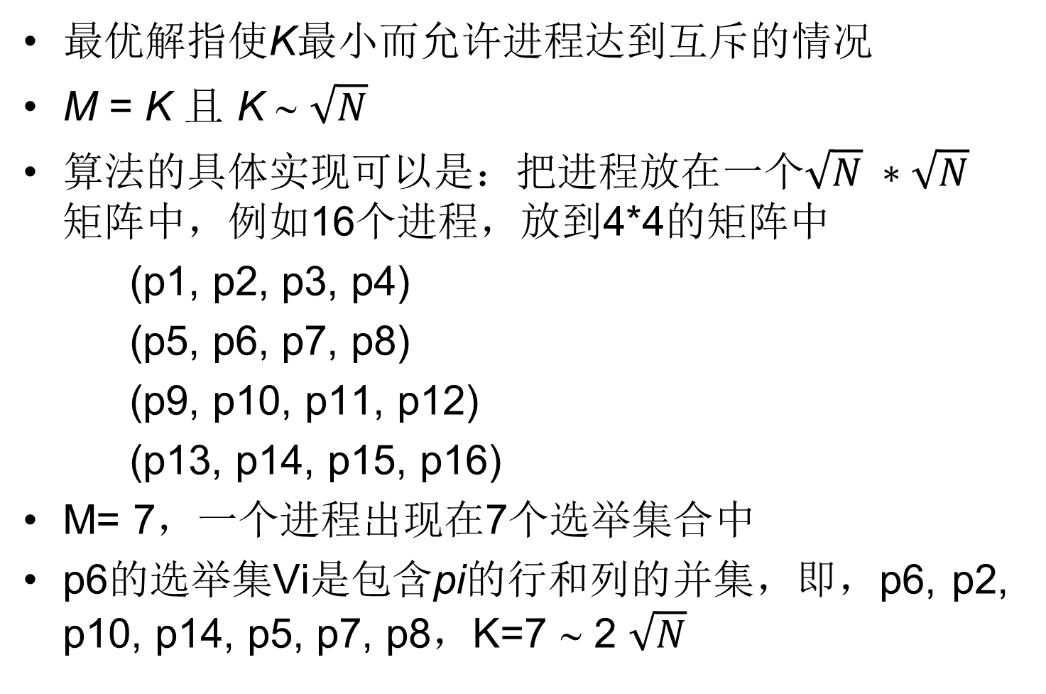
算法实现

Slide 33
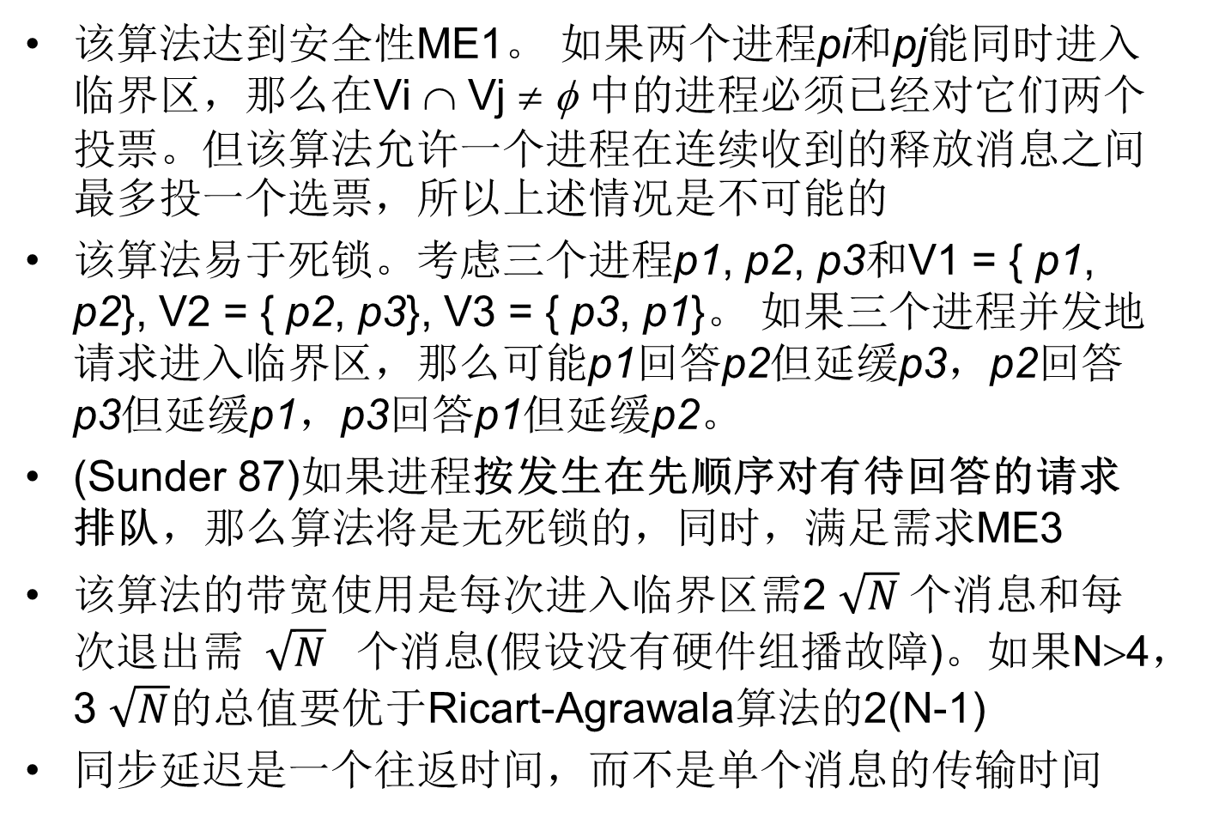
算法分析

Slide 34
Classification of Mutex Algorithms
Property
Mutual Exclusion Algorithm
Token-based
Permission-based
Dynamic
Token-circulating
Token-asking
Static
Logical-structure-based
R-type
M-type
Ring-based
Broadcast-based
Tree-based
Graph-based
Mutual Exclusion
Mechanism
Infrastructured network
Ad hoc network
Network Type

Slide 35
Mutual Exclusion Algorithms
Token-based
the host only needs to keep information about its neighbours
few messages needed to pass the privilege to enter the CS
may need to maintain logical topology
bad performance under a low load level:token circulating
it has to deal with token loss issue
Permission-based
don’t need to maintain the logical topology to pass the token
don’t need to propagate any message if no host requests to enter CS
need to send the request to many hosts

Slide 36
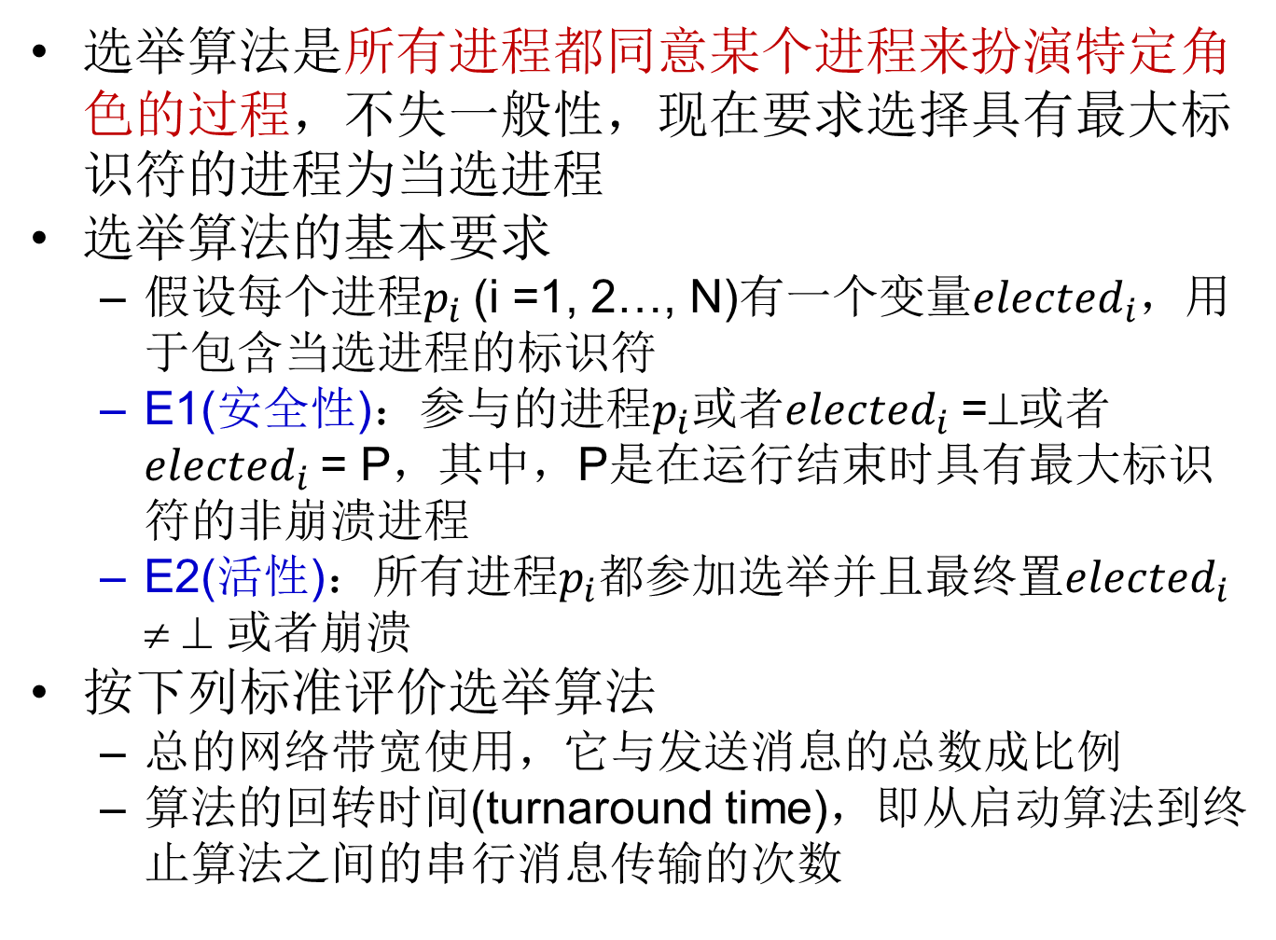
3.2 选举
选举算法是所有进程都同意某个进程来扮演特定角色的过程，不失一般性，现在要求选择具有最大标识符的进程为当选进程
选举算法的基本要求
假设每个进程$p_{i}$(i =1, 2…, N)有一个变量${elected}_{i}$，用于包含当选进程的标识符
E1(安全性)：参与的进程$p_{i}$或者${elected}_{i}$=⊥或者${elected}_{i}$= P，其中，P是在运行结束时具有最大标识符的非崩溃进程
E2(活性)：所有进程$p_{i}$都参加选举并且最终置${elected}_{i}$ ≠ ⊥ 或者崩溃
按下列标准评价选举算法
总的网络带宽使用，它与发送消息的总数成比例
算法的回转时间(turnaround time)，即从启动算法到终止算法之间的串行消息传输的次数

Slide 37
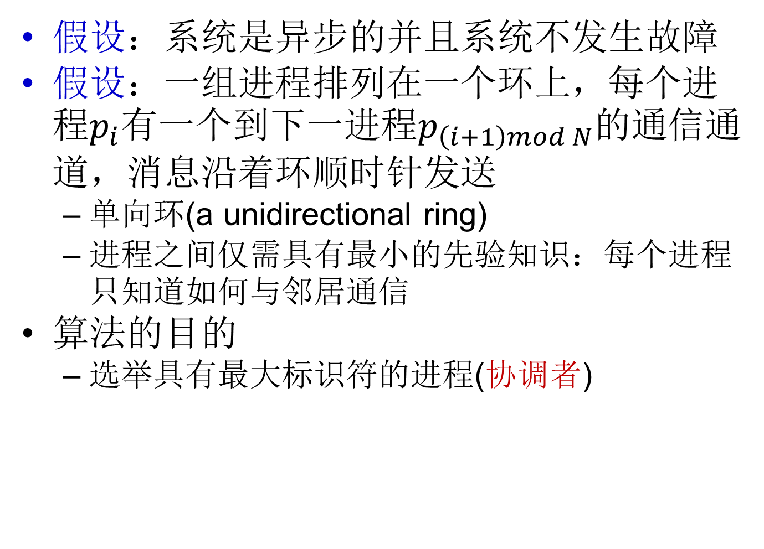
基于环的选举算法(Chang and Roberts 1979)
假设：系统是异步的并且系统不发生故障
假设：一组进程排列在一个环上，每个进程$p_{i}$有一个到下一进程$p_{\left(i+1\right)mod N}$的通信通道，消息沿着环顺时针发送
单向环(a unidirectional ring)
进程之间仅需具有最小的先验知识：每个进程只知道如何与邻居通信
算法的目的
选举具有最大标识符的进程(协调者)

Slide 38
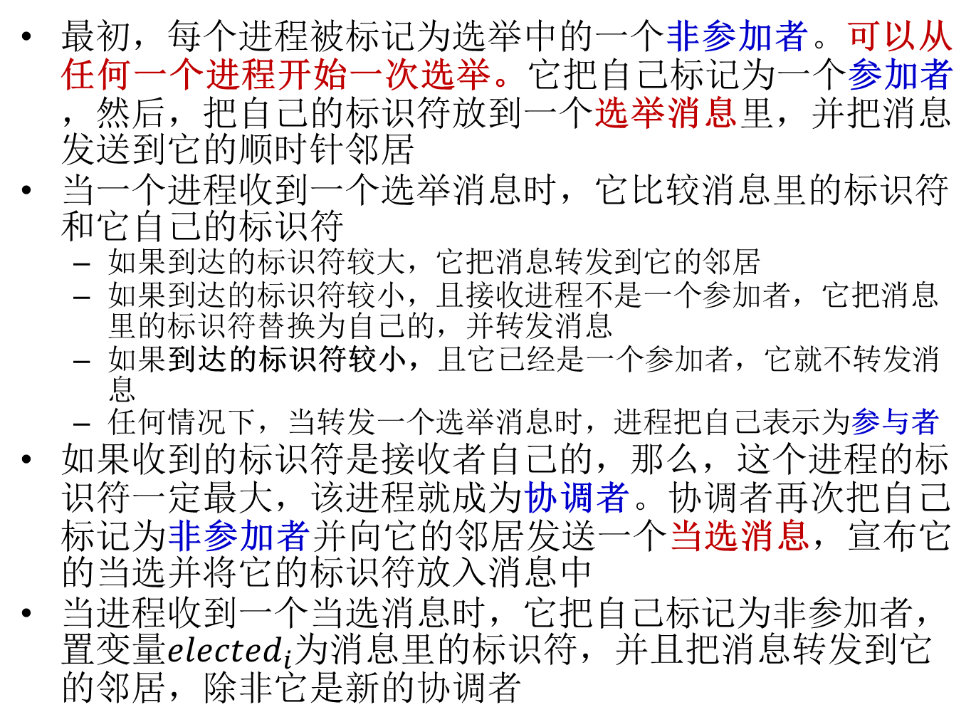
基于环的选举算法
最初，每个进程被标记为选举中的一个非参加者。可以从任何一个进程开始一次选举。它把自己标记为一个参加者，然后，把自己的标识符放到一个选举消息里，并把消息发送到它的顺时针邻居
当一个进程收到一个选举消息时，它比较消息里的标识符和它自己的标识符
如果到达的标识符较大，它把消息转发到它的邻居
如果到达的标识符较小，且接收进程不是一个参加者，它把消息里的标识符替换为自己的，并转发消息
如果到达的标识符较小，且它已经是一个参加者，它就不转发消息
任何情况下，当转发一个选举消息时，进程把自己表示为参与者
如果收到的标识符是接收者自己的，那么，这个进程的标识符一定最大，该进程就成为协调者。协调者再次把自己标记为非参加者并向它的邻居发送一个当选消息，宣布它的当选并将它的标识符放入消息中
当进程收到一个当选消息时，它把自己标记为非参加者，置变量${elected}_{i}$为消息里的标识符，并且把消息转发到它的邻居，除非它是新的协调者

Slide 39
例子：最坏情况
30
30 elected
30 elected
30
28
30
30
此时消息中为28
30 elected

Slide 40
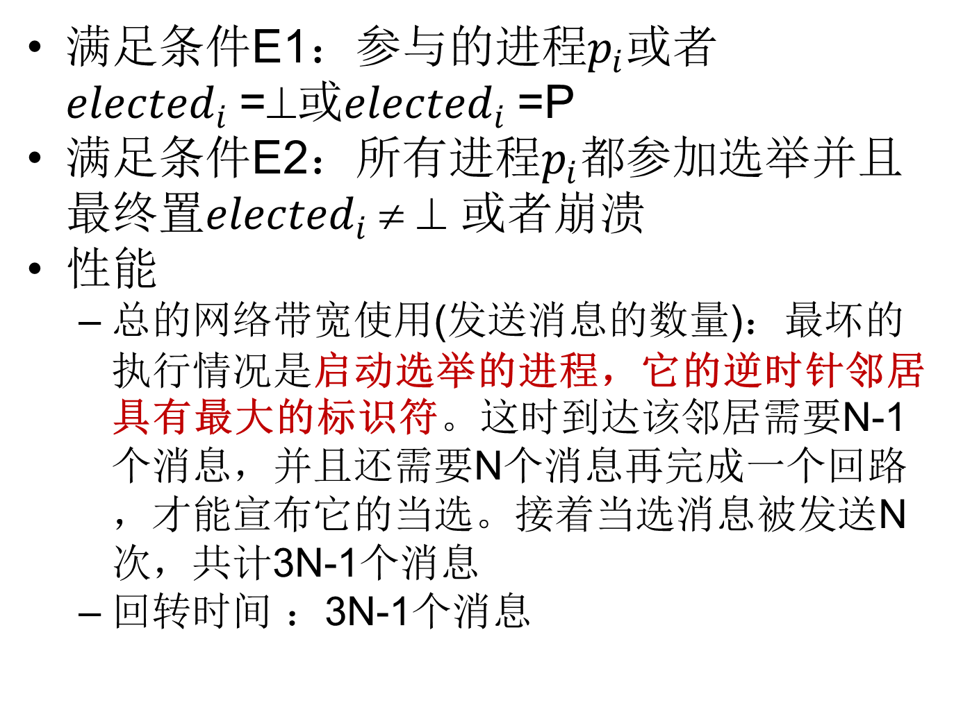
算法分析
满足条件E1：参与的进程$p_{i}$或者${elected}_{i}$=⊥或${elected}_{i}$=P
满足条件E2：所有进程$p_{i}$都参加选举并且最终置${elected}_{i}$≠ ⊥ 或者崩溃
性能
总的网络带宽使用(发送消息的数量)：最坏的执行情况是启动选举的进程，它的逆时针邻居具有最大的标识符。这时到达该邻居需要N-1个消息，并且还需要N个消息再完成一个回路，才能宣布它的当选。接着当选消息被发送N次，共计3N-1个消息
回转时间 ：3N-1个消息

Slide 41
霸道(Bully)算法(Garcia-Molina1982)
假设：进程可能崩溃；消息传递是可靠的，并能在一段时间内完成；所有进程知道对方的标识符(pid)
假设：系统是同步的，并允许在选举期间进程崩溃
可以构造一个可靠的故障检测器来检测进程故障
基于环的算法可用于异步系统，霸道算法仅用于同步系统
基于环的算法是假设没有故障的，霸道算法假定进程可能在选举期间崩溃
基于环的算法假定进程相互之间具有最小的先验知识，霸道算法假定每个进程知道哪些进程有较高的标识符，并且可以和所有这些进程通信
霸道算法中有三种类型的消息
选举消息用于宣布选举
回答消息用于回复选举消息
协调者消息用于宣布当选进程的身份——新的“协调者”
一个进程在通过超时发现协调者已经出现故障时开始一次选举
几个进程可能并发地观察到此现象

Slide 42
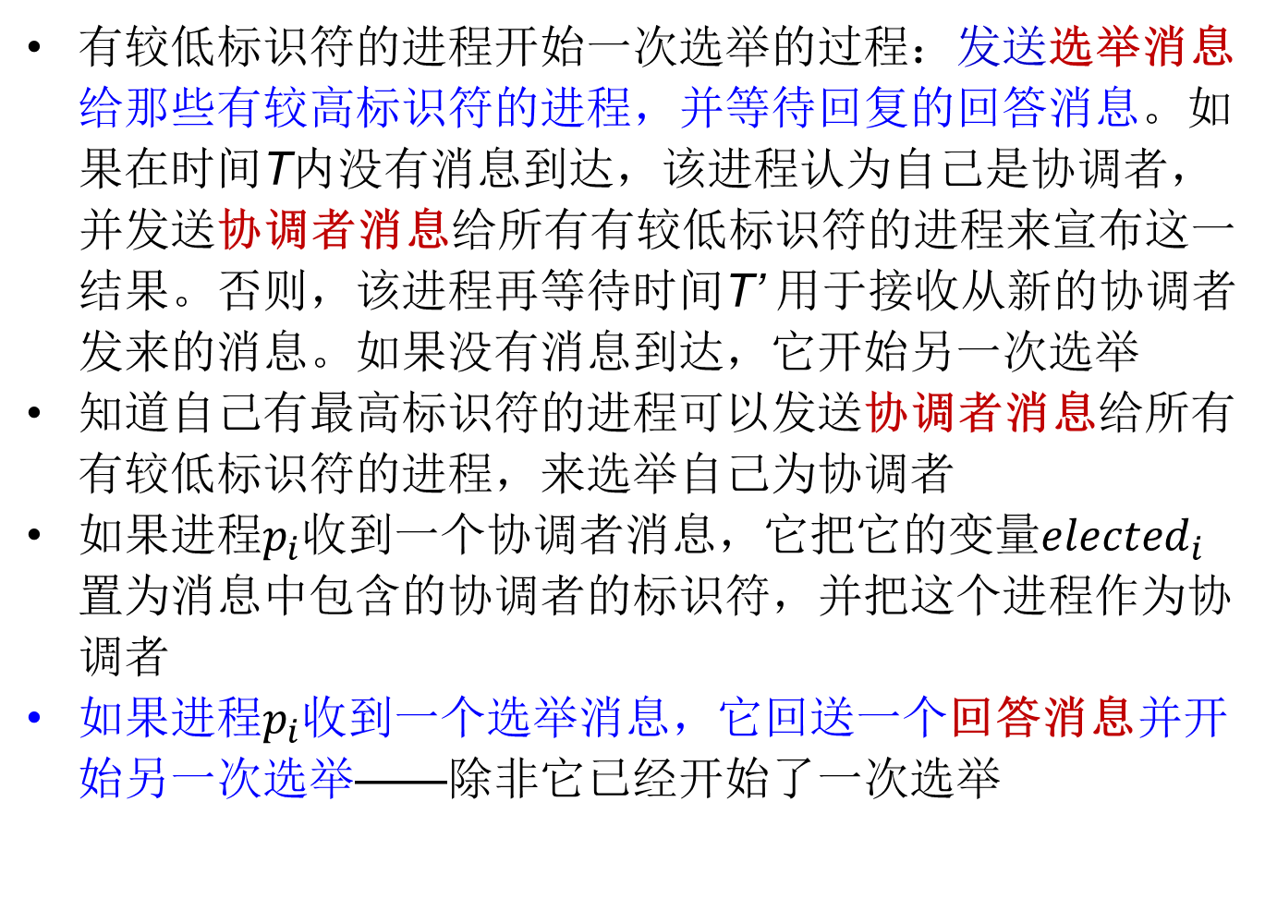
霸道算法-算法的要点
有较低标识符的进程开始一次选举的过程：发送选举消息给那些有较高标识符的进程，并等待回复的回答消息。如果在时间T内没有消息到达，该进程认为自己是协调者，并发送协调者消息给所有有较低标识符的进程来宣布这一结果。否则，该进程再等待时间T’ 用于接收从新的协调者发来的消息。如果没有消息到达，它开始另一次选举
知道自己有最高标识符的进程可以发送协调者消息给所有有较低标识符的进程，来选举自己为协调者
如果进程$p_{i}$收到一个协调者消息，它把它的变量${elected}_{i}$置为消息中包含的协调者的标识符，并把这个进程作为协调者
如果进程$p_{i}$收到一个选举消息，它回送一个回答消息并开始另一次选举——除非它已经开始了一次选举

Slide 43
霸道算法-例子
P1开始另一次选举
P2当选协调者

Slide 44
算法分析-I
如果没有进程被替换(指进程崩溃后重启)，算法满足条件E1
如果允许进程被替换，那么如果崩溃的进程被替换为具有相同标识符的进程，这个算法就不能保证满足E1
一个进程已经检测到进程p的崩溃，然后决定它有最高的标识符，这时，p的替换进程激活了，替换p的进程可能决定它有最高的标识符。两个进程可能并发地宣布它们自己为协调者。因为在消息的传输顺序上没有保证，所以，这些消息的接收者可能就谁是协调者得出不同的结论
如果假定的超时值被证明是不准确的，即如果进程的故障检测器是不可靠的，条件E1可能会被违反
假设或者p3没有崩溃但运行异乎寻常地慢(即系统同步的假定是不正确的)，或者p3已经崩溃但被替换。正在p2发送它的协调者消息时，p3 (或替换者)也做同样的事情。p2在发送自己的协调者消息后收到p3的，因此置elected2 = p3。 由于消息传输延迟，p1在收到p3的协调者消息后收到p2的，因此最终elected1 = p2。条件E1被违反

Slide 45
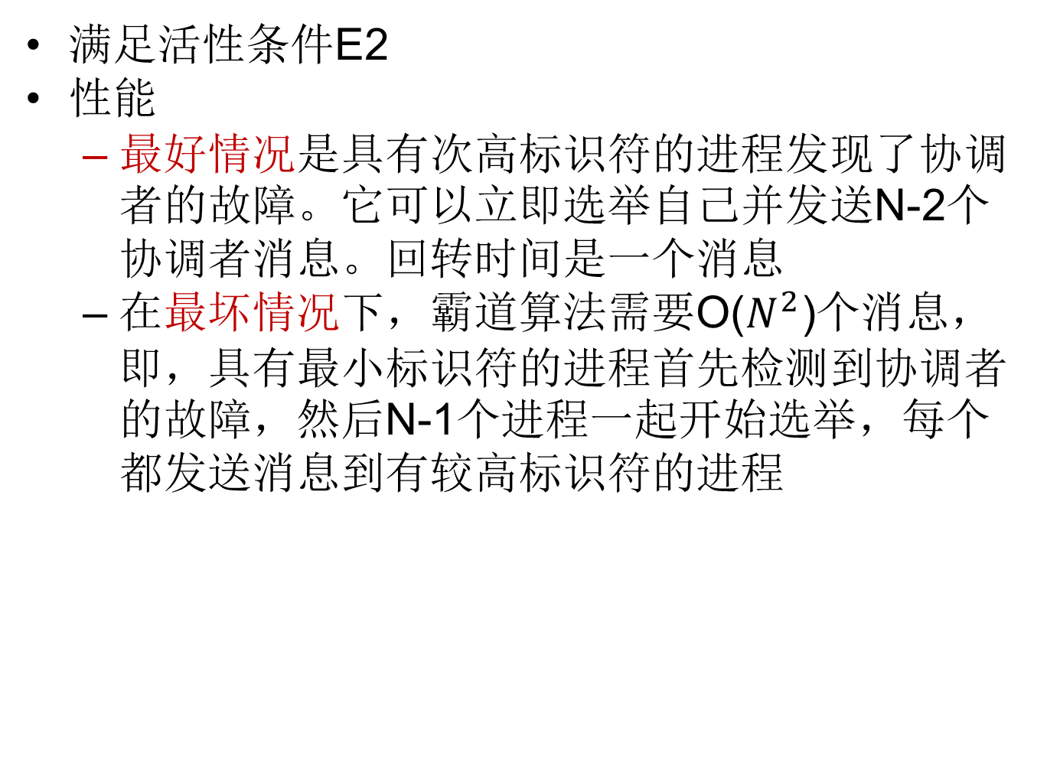
算法分析-II
满足活性条件E2
性能
最好情况是具有次高标识符的进程发现了协调者的故障。它可以立即选举自己并发送N-2个协调者消息。回转时间是一个消息
在最坏情况下，霸道算法需要O($N^{2}$)个消息，即，具有最小标识符的进程首先检测到协调者的故障，然后N-1个进程一起开始选举，每个都发送消息到有较高标识符的进程

Slide 46
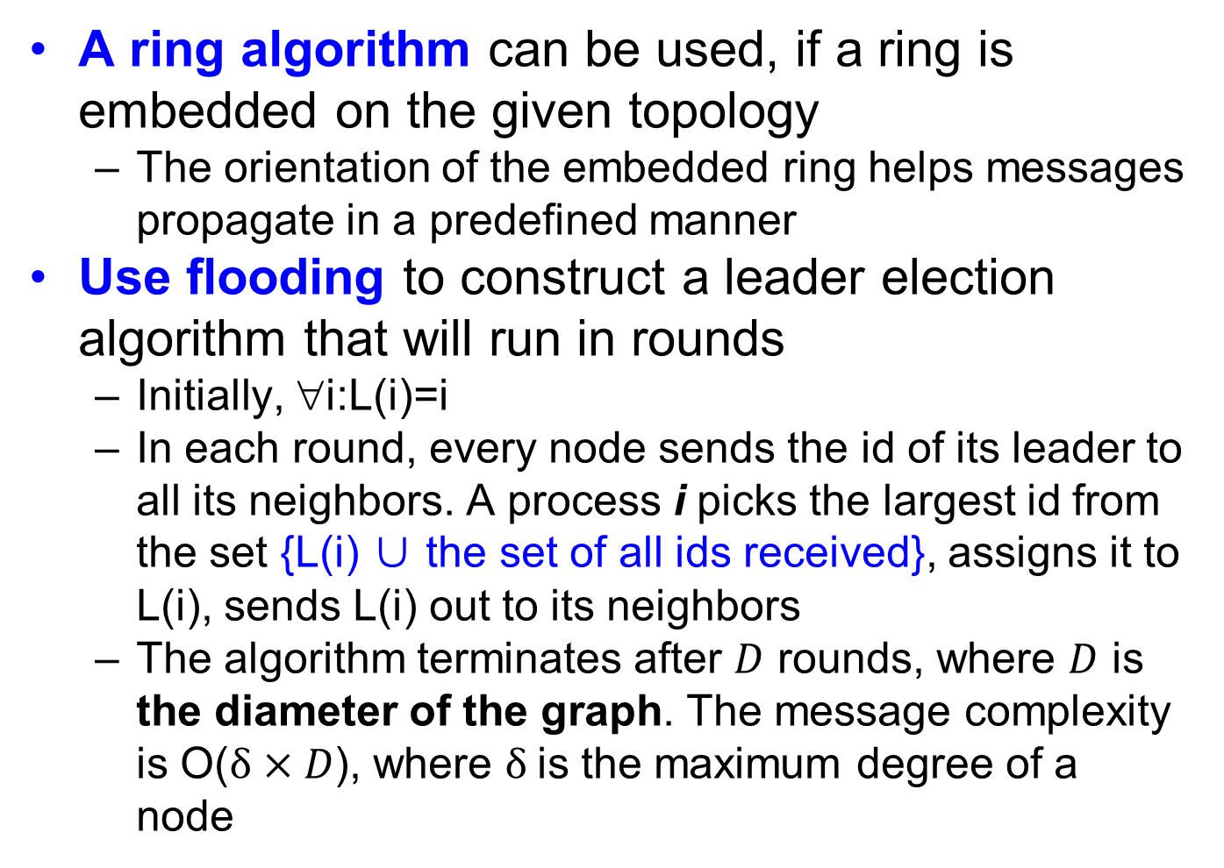
Election in Arbitrary Networks
A ring algorithm can be used, if a ring is embedded on the given topology
The orientation of the embedded ring helps messages propagate in a predefined manner
Use flooding to construct a leader election algorithm that will run in rounds
Initially, ∀i:L(i)=i
In each round, every node sends the id of its leader to all its neighbors. A process i picks the largest id from the set {L(i) ∪ the set of all ids received}, assigns it to L(i), sends L(i) out to its neighbors
The algorithm terminates after $D$ rounds, where $D$ is the diameter of the graph. The message complexity is O($δ×D$), where $δ$is the maximum degree of a node

Slide 47
Elections in Wireless Environments
Challenges:
It has to handle failing nodes and partitioning networks
It has to handle disconnection and doze mode of hosts
It has to provide scalability
An algorithm to elect the best leader in a MANET:
Source node can initiate an election by sending an Election message to its immediate neighbors
When a node receives an Election for the first time, it designates the sender as its parent and subsequently sends out an Election message to all its immediate neighbors
When a node receives an Election message from a node other than its parent, it merely acknowledges the receipt, piggybacking the other information such as its battery lifetime and other resource capacities,
When node R has designated node Q as its parent, it forwards the Election message to its immediate neighbors and waits for acknowledgments to come in before acknowledging the Election message from Q.
Notes:
(From ICNP 2004)

Slide 48
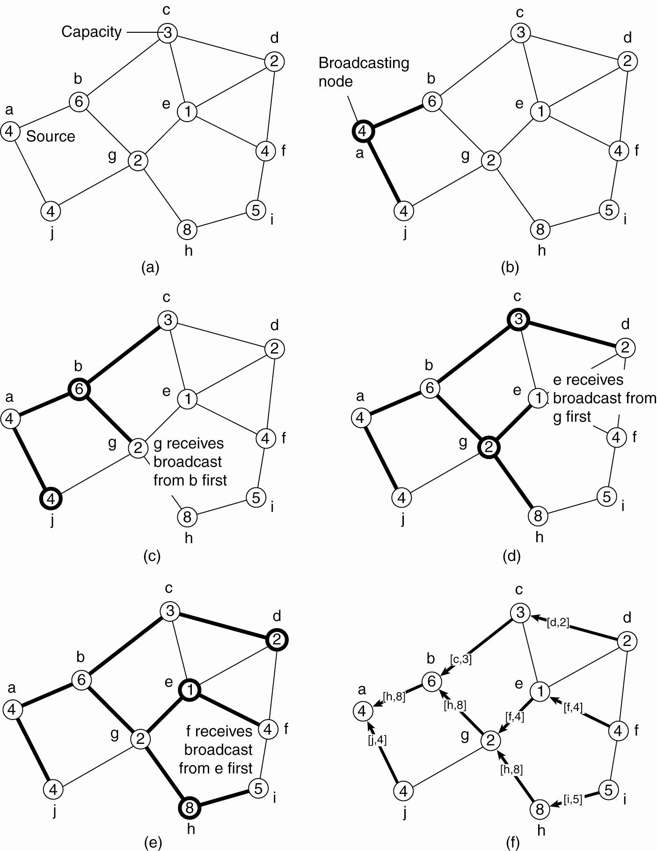
An Example of Election in a MANET- I
Election algorithm in a wireless network, with node a as the source. (a) Initial network. (b)–(e) The build-tree phase

Slide 49
An Example of Election in a MANET- II
Election algorithm in a wireless network, with node a as the source. (a) Initial network. (b)–(e) The build-tree phase

Slide 50
An Example of Election in a MANET - III
(e) The build-tree phase. (f) Reporting of best node to source.

Slide 51
Leader Election for Replicated Services Using Application Scores/Middleware 2011
Replicated Services: ZooKeeper, Chubby
In replicated services, the leader performs more work than other servers, since it processes more messages and generates state updates
One initial requirement regarding leader election in ZooKeeper was the ability to elect the server with the longest history of state updates among a quorum of servers
Performance-Oriented Leader Election
Mean request latency: the mean time required for clients to complete a request
Worst-case request latency
Recovery time: the time it takes for a new leader to start operating again after the failure of the previous leader

Slide 52
3.3 排序组播
组播不能保证消息按序到达
用单播实现组播时，同属一组的一些成员从同一个发送者接收的数据包的顺序可能与其他一些成员不一样
应用需要有序组播
排序：BBS，在最低程度上，BBS需要FIFO序的组播，另外，一个贴子和它的回贴应该是有序出现的即按因果序出现
一个组称为是封闭的组，如果只有组的成员可以组播到它
一个组称为是开放的组，如果组外的进程可以发送组播消息给它
重叠组，一个进程属于两个组

Slide 53
有序组播
FIFO排序：如果一个进程发multicast(g, m)，然后发multicast(g, m’)，那么，每个传递m’的正确的进程将在m’前传递m
因果排序：如果 multicast(g, m) → multicast(g, m’)，其中 → 是发生在先关系且只由g的成员之间发送的消息引起，那么，任何传递m’的正确的进程将在m’前传递m
因果排序隐含FIFO排序
全排序：如果一个正确的进程在传递m’前传递消息m，那么，任何其它传递m’的正确的进程将在m’前传递m
全排序未必是FIFO或因果排序
混合排序：FIFO-全排序，因果-全排序

Slide 54
Assumptions
Processes communicate reliably over one-to-one channels
Processes may fail only by crashing
For ordering property, processes are restricted to being members of at most one group at a time, otherwise processes are allowed to belong to several groups
multicast(g,m) sends the message m to all members of the group g of processes
deliver(m) delivers the message m sent by multicast to the calling process
Every message m carries the unique identifier of the process sender(m) that sent it , and the unique destination group identifier group(m)

Slide 55
Basic multicast primitive B-multicast
B-multicast: a correct process will eventually deliver the message, as long as the multicaster does not crash
B-deliver: the corresponding basic delivery primitive
A way to implement B-multicast :
To B-multicast(g,m):
for each process p∈g, send(p,m);
//send is a reliable one-to-one operation
On receive(m) at p: B-deliver(m) at p
Ack && Ack-implosion

Slide 56
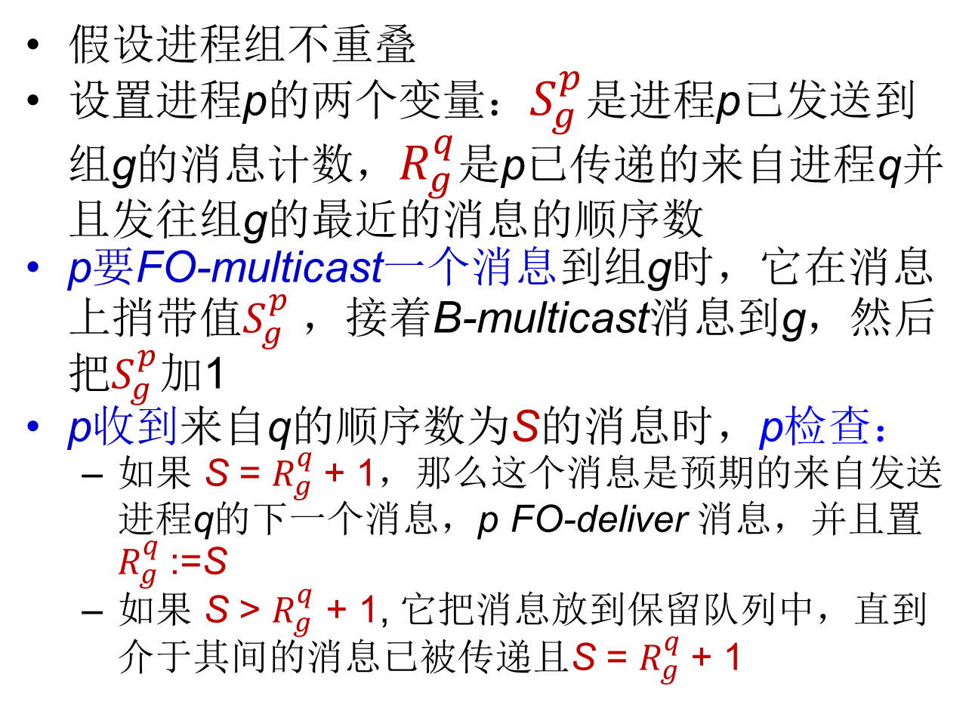
实现FIFO排序的组播FO-multicast
假设进程组不重叠
设置进程p的两个变量：$S_{g}^{p}$是进程p已发送到组g的消息计数，$R_{g}^{q}$是p已传递的来自进程q并且发往组g的最近的消息的顺序数
p要FO-multicast一个消息到组g时，它在消息上捎带值$S_{g}^{p}$，接着B-multicast消息到g，然后把$S_{g}^{p}$加1
p收到来自q的顺序数为S的消息时，p检查：
如果 S = $R_{g}^{q}$+ 1，那么这个消息是预期的来自发送进程q的下一个消息，p FO-deliver 消息，并且置 $R_{g}^{q}$:=S
如果 S > $R_{g}^{q}$ + 1, 它把消息放到保留队列中，直到介于其间的消息已被传递且S = $R_{g}^{q}$+ 1

Slide 57
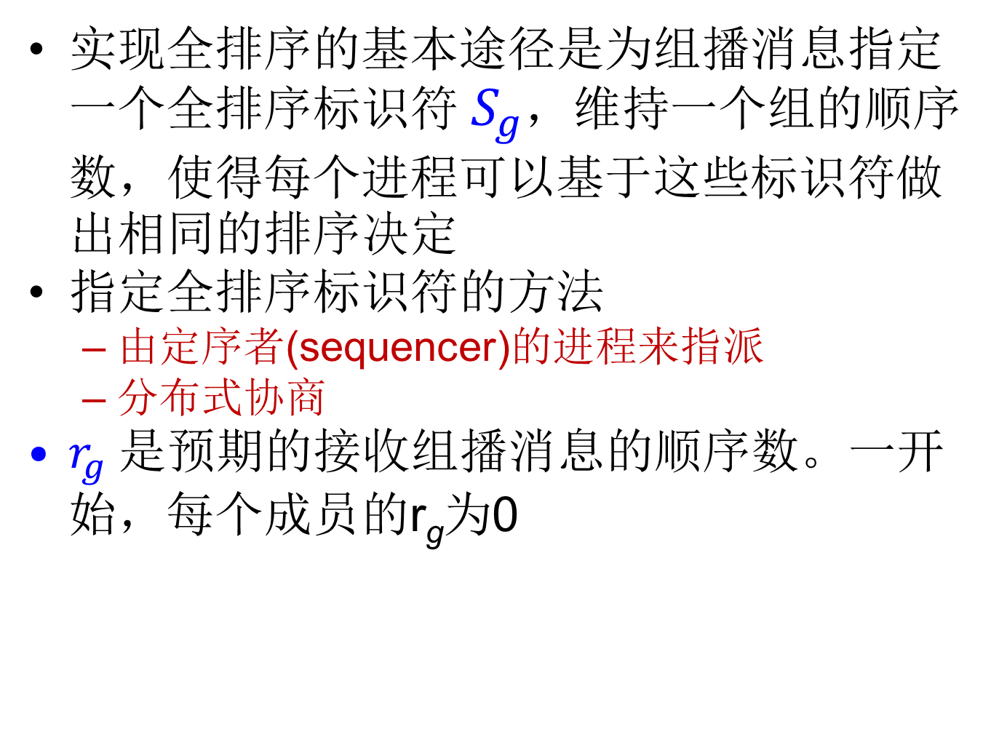
全排序组播
实现全排序的基本途径是为组播消息指定一个全排序标识符$S_{g}$，维持一个组的顺序数，使得每个进程可以基于这些标识符做出相同的排序决定
指定全排序标识符的方法
由定序者(sequencer)的进程来指派
分布式协商
$r_{g}$是预期的接收组播消息的顺序数。一开始，每个成员的r_{g}为0

Slide 58
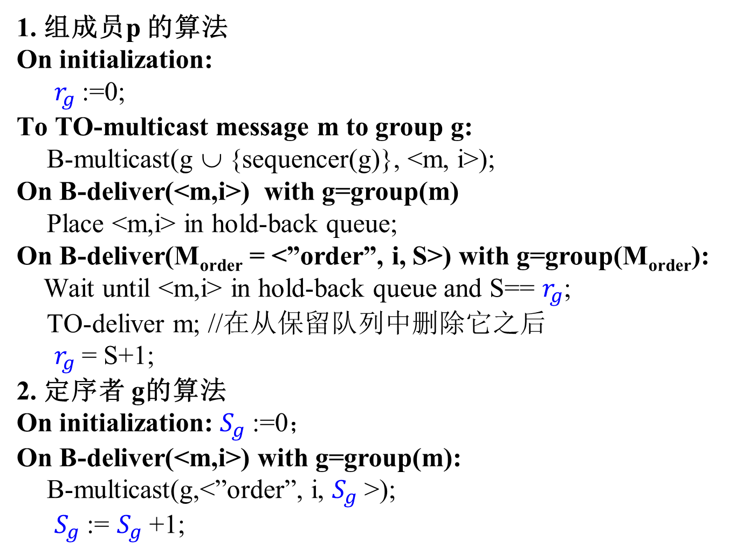
实现全排序组播TO-multicast 算法-I
1. 组成员p 的算法
On initialization:
$r_{g}$:=0;
To TO-multicast message m to group g:
B-multicast(g ∪ {sequencer(g)}, <m, i>);
On B-deliver(<m,i>) with g=group(m)
Place <m,i> in hold-back queue;
On B-deliver(M_{order} = <”order”, i, S>) with g=group(M_{order}):
Wait until <m,i> in hold-back queue and S== $r_{g}$;
TO-deliver m; //在从保留队列中删除它之后
$r_{g}$= S+1;
2. 定序者 g的算法
On initialization: $S_{g}$:=0；
On B-deliver(<m,i>) with g=group(m):
B-multicast(g,<”order”, i, $S_{g}$>);
$S_{g}$:= $S_{g}$+1;

Slide 59
实现全排序组播TO-multicast算法-II

Slide 60
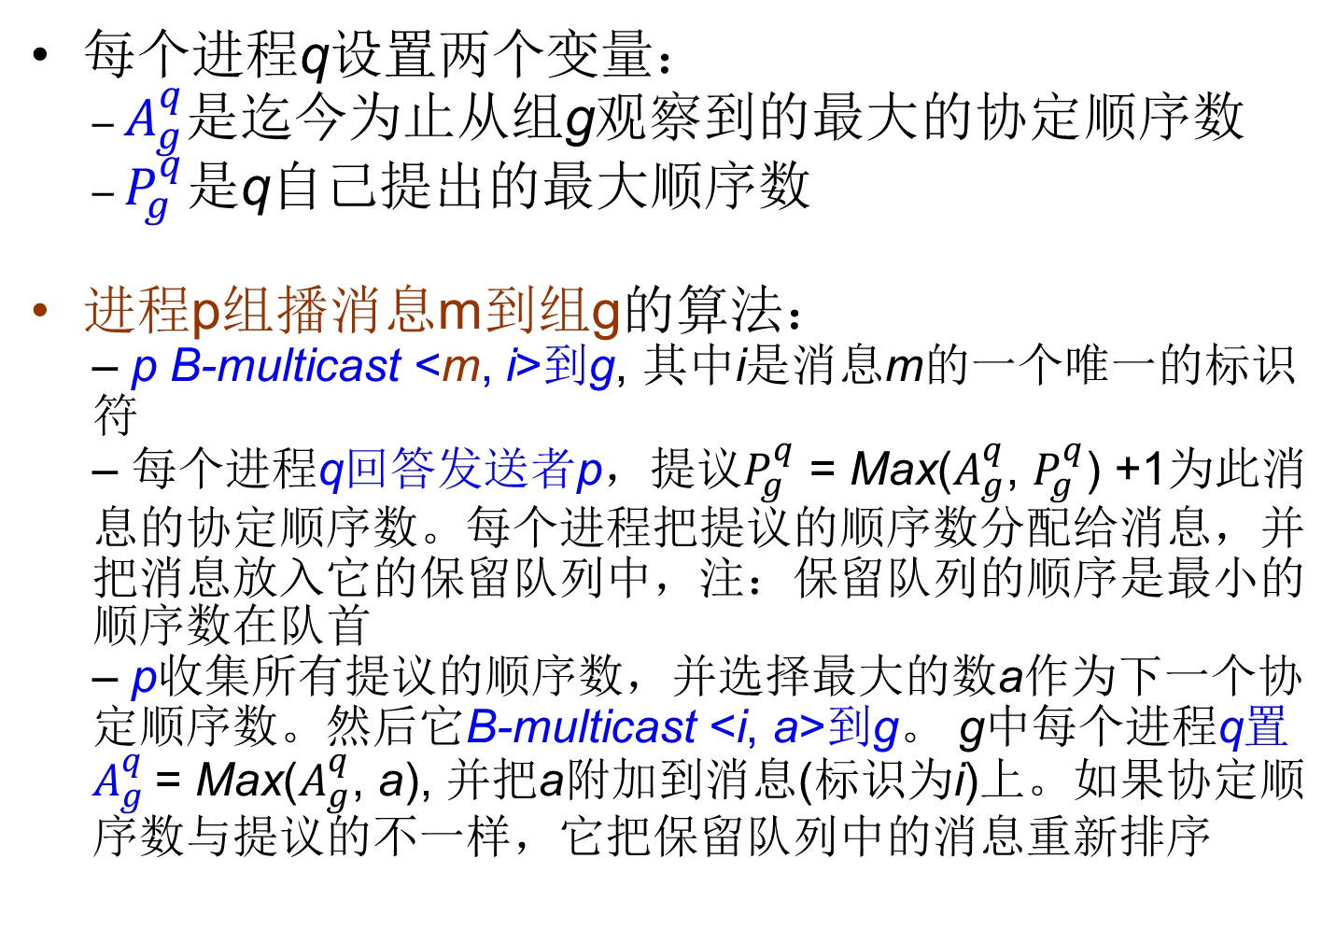
实现全排序组播TO-multicast算法-II
每个进程q设置两个变量：
$A_{g}^{q}$是迄今为止从组g观察到的最大的协定顺序数
$P_{g}^{q}$是q自己提出的最大顺序数
进程p组播消息m到组g的算法：
p B-multicast <m, i>到g, 其中i是消息m的一个唯一的标识符
每个进程q回答发送者p，提议$P_{g}^{q}$ = Max($A_{g}^{q}$, $P_{g}^{q}$) +1为此消息的协定顺序数。每个进程把提议的顺序数分配给消息，并把消息放入它的保留队列中，注：保留队列的顺序是最小的顺序数在队首
p收集所有提议的顺序数，并选择最大的数a作为下一个协定顺序数。然后它B-multicast <i, a>到g。 g中每个进程q置$A_{g}^{q}$= Max($A_{g}^{q}$, a), 并把a附加到消息(标识为i)上。如果协定顺序数与提议的不一样，它把保留队列中的消息重新排序

Slide 61
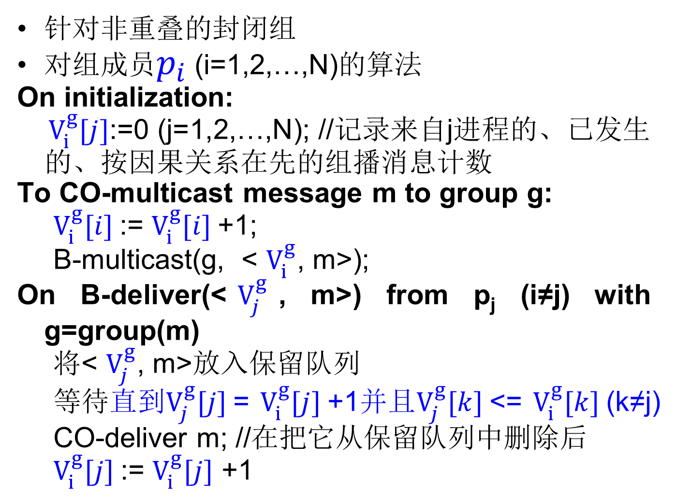
实现因果排序组播CO-multicast
针对非重叠的封闭组
对组成员$p_{i}$ (i=1,2,…,N)的算法
On initialization:
$V_{i}^{g}[j]$:=0 (j=1,2,…,N); //记录来自j进程的、已发生的、按因果关系在先的组播消息计数
To CO-multicast message m to group g:
$V_{i}^{g}[i]$:= $V_{i}^{g}[i]$+1;
B-multicast(g, < $V_{i}^{g}$, m>);
On B-deliver(<$V_{j}^{g}$, m>) from p_{j} (i≠j) with g=group(m)
将< $V_{j}^{g}$, m>放入保留队列
等待直到$V_{j}^{g}[j]$= $V_{i}^{g}[j]$+1并且$V_{j}^{g}[k]$<= $V_{i}^{g}[k]$(k≠j)
CO-deliver m; //在把它从保留队列中删除后
$V_{i}^{g}[j]$:= $V_{i}^{g}[j]$ +1

Slide 62

CO-multicast
因果序组播：
co-multicast(g,m1)→co-multicast (g,m2)→
co-multicast (g,m3)→co-multicast (g,m4)
$P_{i}$，作为组播的接收者，
本地的$V_{i}^{g}[j]$+1=收到$的V_{j}^{g}[j]$：本地已收到 早先从发送者$P_{j}$发来的因果组播消息
本地的 $V_{i}^{g}[k]$(k≠j)>=收到的$V_{j}^{g}\left[k\right]$：本地已收到 发送者$P_{j}$已收到的来自其他进程$P_{k}$的因果组播消息
Pi
Pj

